Slide 1
Stakeholder’s Summary
Objective: Reduce safety and financial risk in aircraft acquisition
Outcome: Evidence based shortlist of lower risk aircraft models.

Slide 2
Business Risk Context
  Aircraft purchases involve high capital and long-term exposure.
  Wrong selection increases safety, insurance, and regulatory risk.

Slide 3
Data Foundation
42 years of aviation accident data (1948,1982-2022)
Commercial and private aircrafts are featured
U.S.A and international operations.

Slide 4
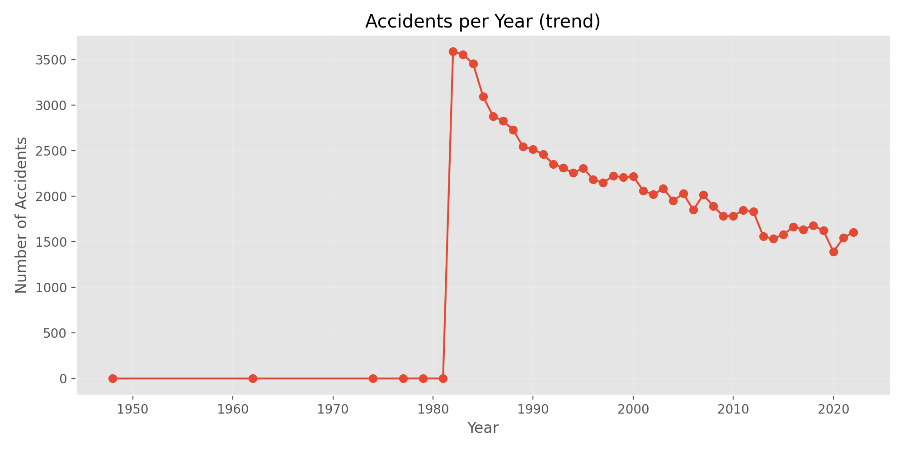
Accidents Safety Trends Over Time
Overall aviation safety has improved over time.
Modern aircraft operate under stronger safety standars.

Slide 5
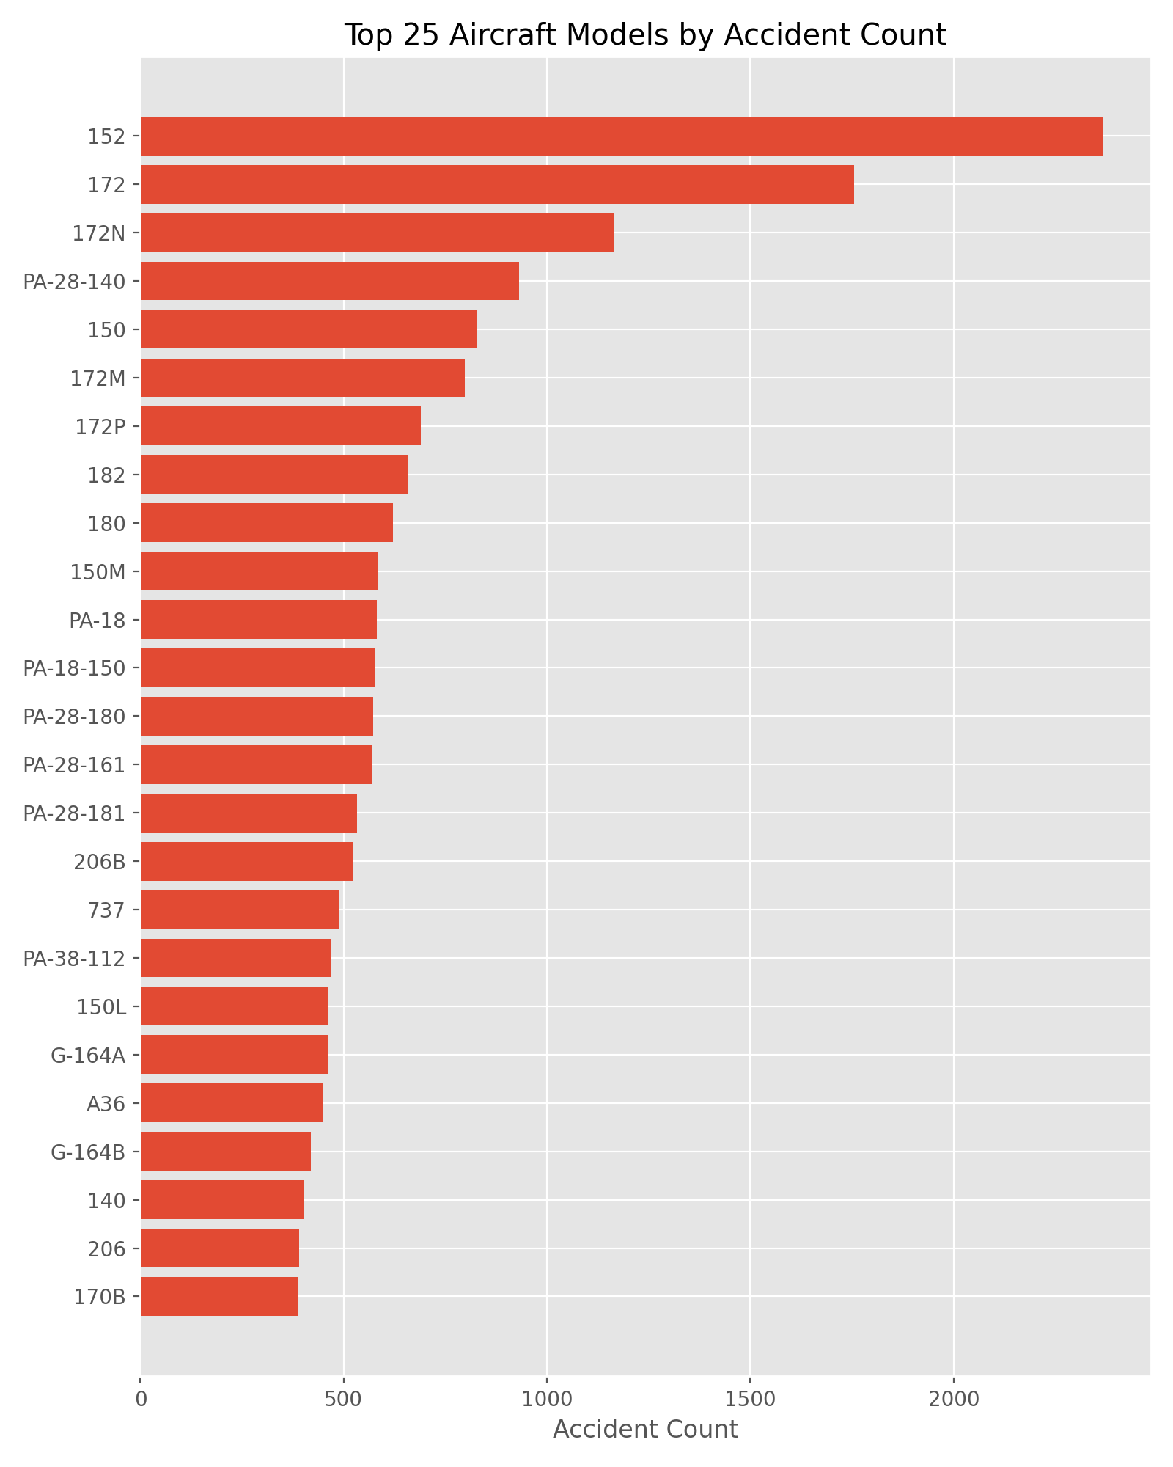
Accident Frequency by Aircraft Model
High accident counts often reflect higher usage.
Frequency alone does not show higher risk

Slide 6
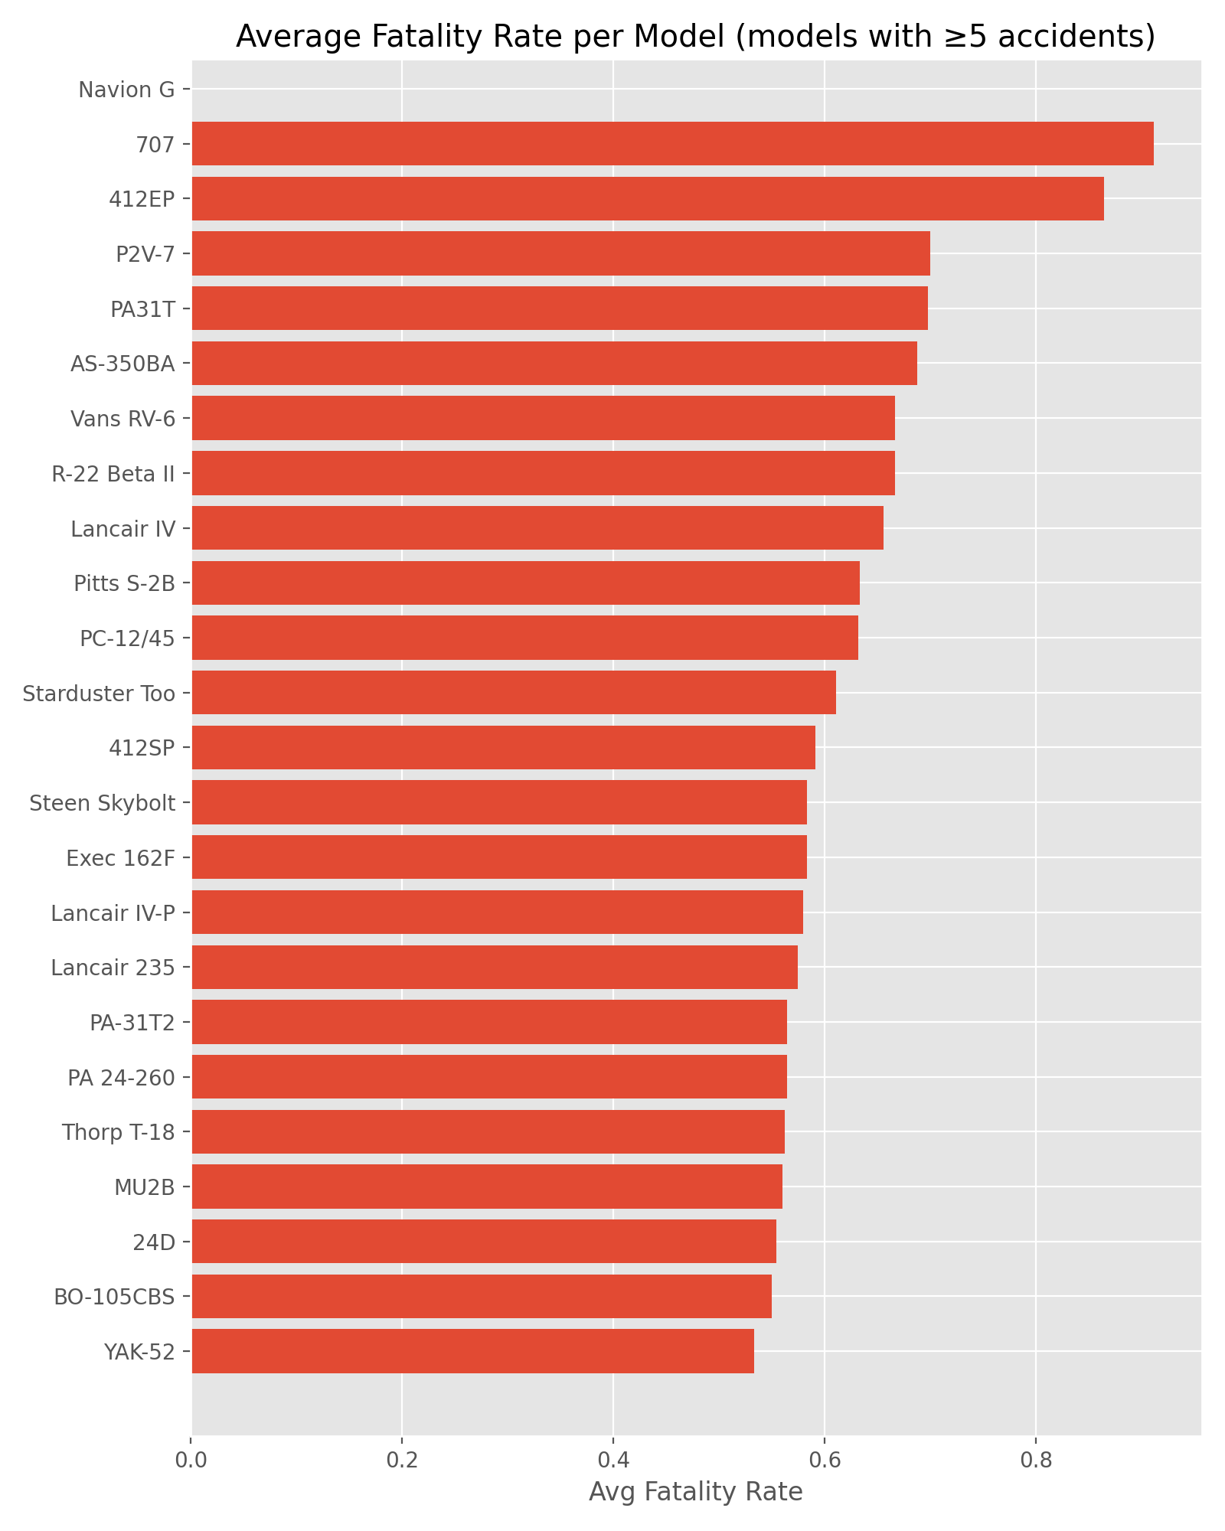
Injury Severity Matters More than Frequency of Accidents
Why injury Severity Matters:
Severity determines human and financial impact.
Low risk aircrafts minimizes severe outcomes.

Slide 7
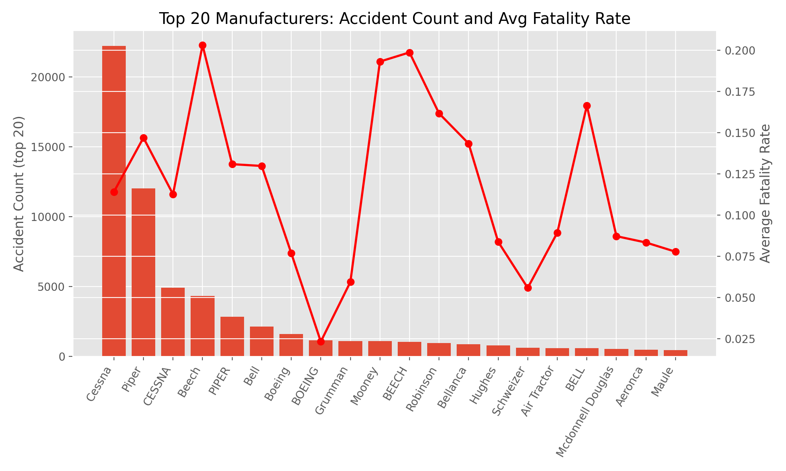
Identified Low Risk Aircrafts Models
Models selected based on low fatality and severity scores.
Relative severity score, lower is better

Slide 8
Business Value
Reduced operational risk
Improved insurer confidence
Predictable long term costs

Slide 9
Stakeholder’s Recommendations
Prioritize low severity aircraft models
Avoid reputation only decisions
Embed safety metrics into procurement

Slide 10
Indicative Low Risk Aircraft Shortlist
Cessna 172
Cessna 182
Piper PA-28
Beechcraft Bonanza
Diamond DA40

